Slide 2
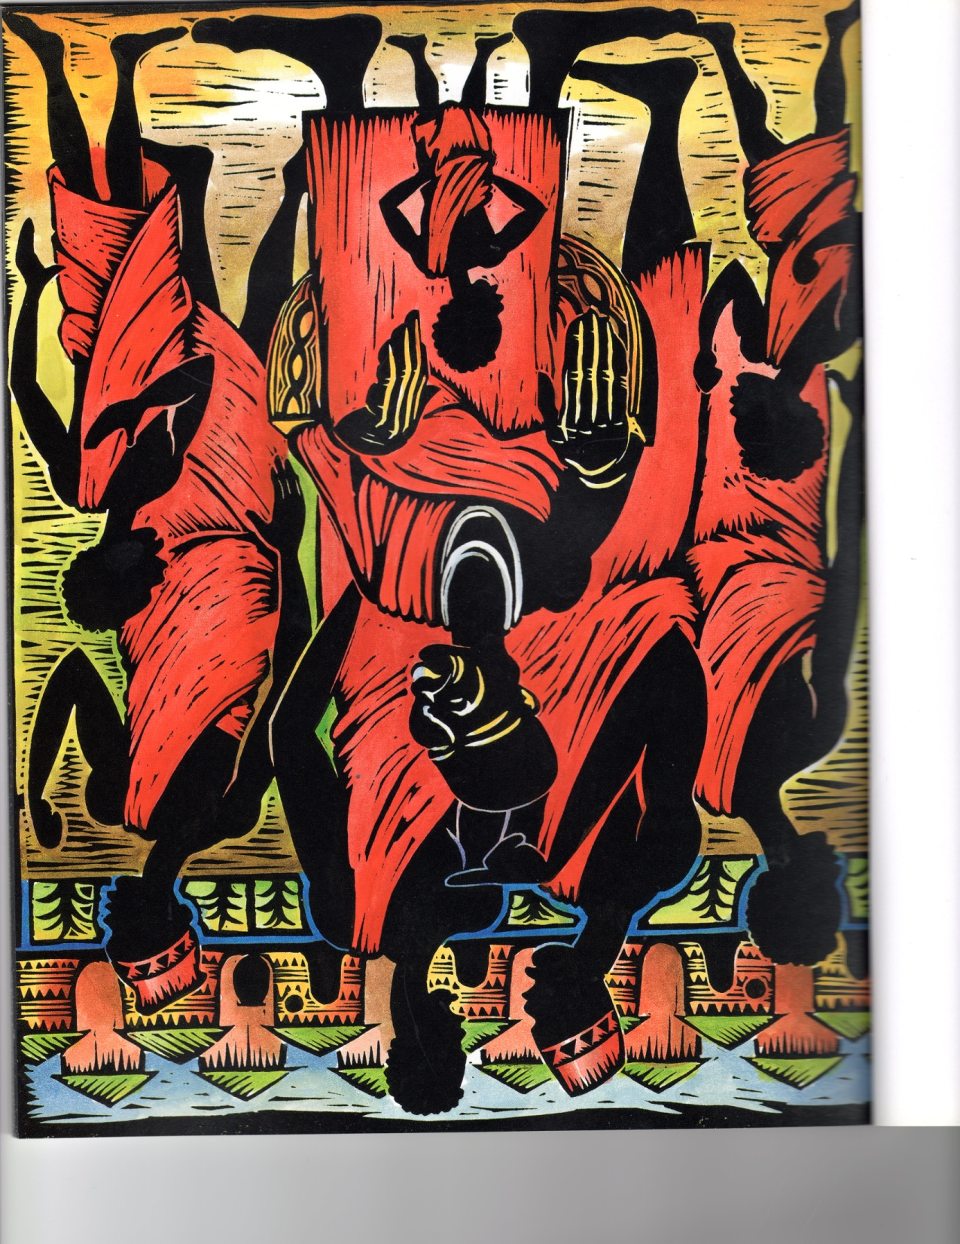
Father & Sons

Slide 3
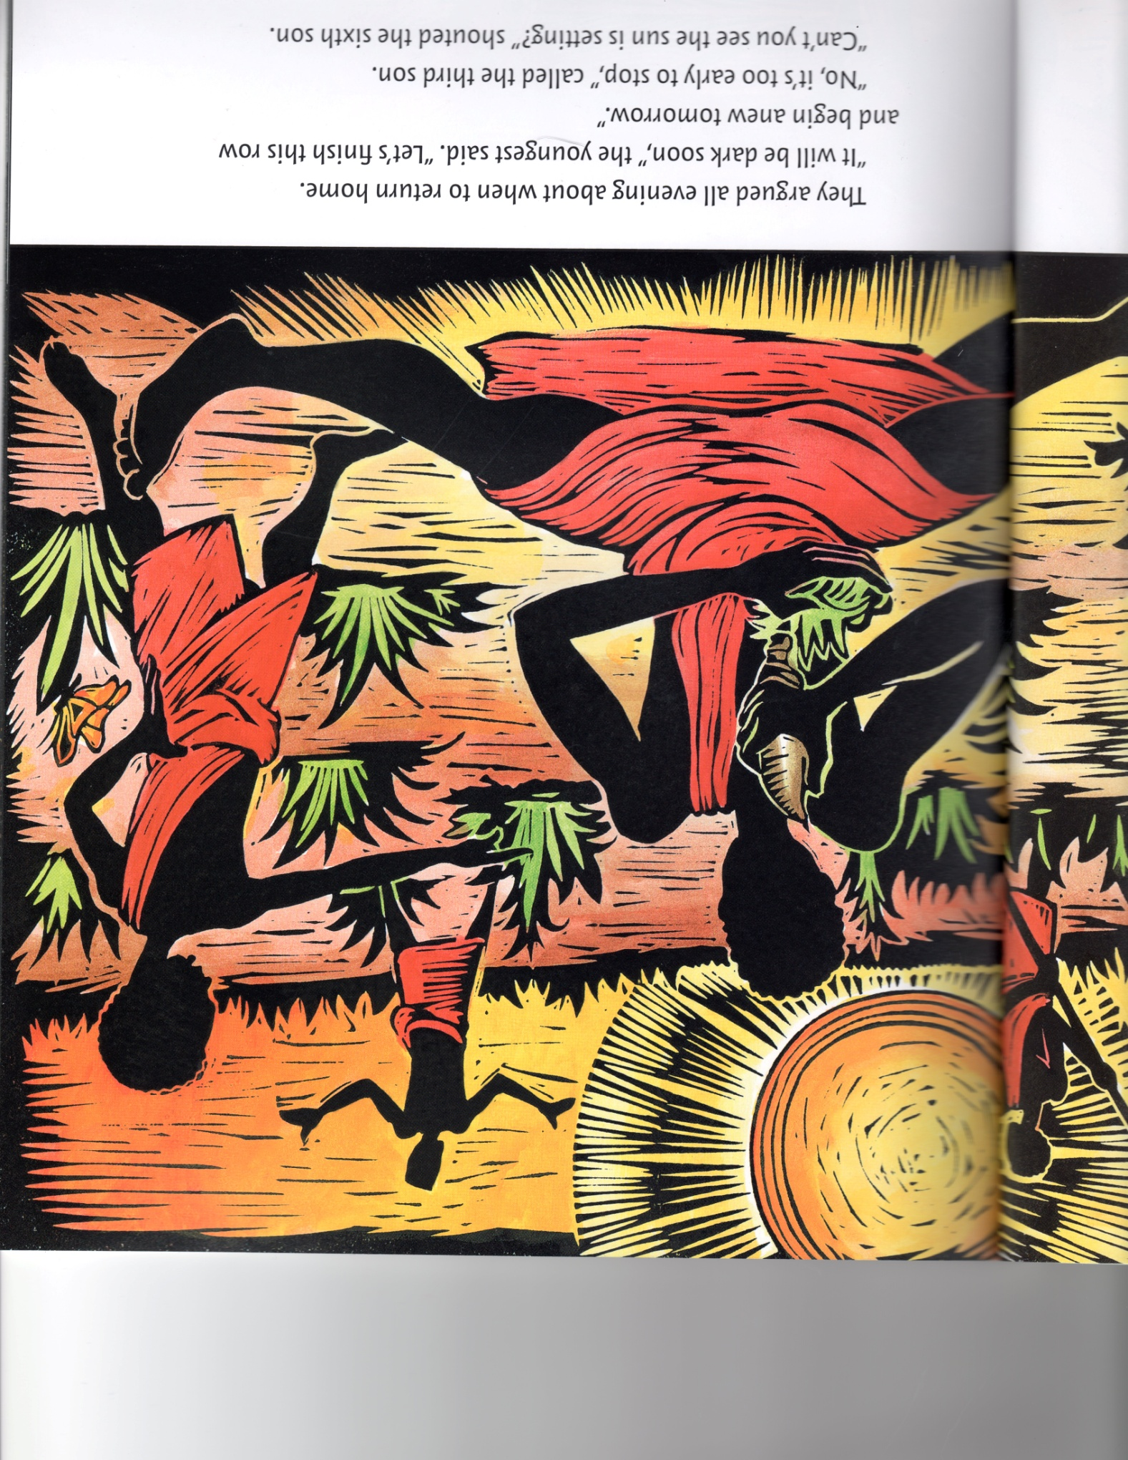
Quarreling…

Slide 4
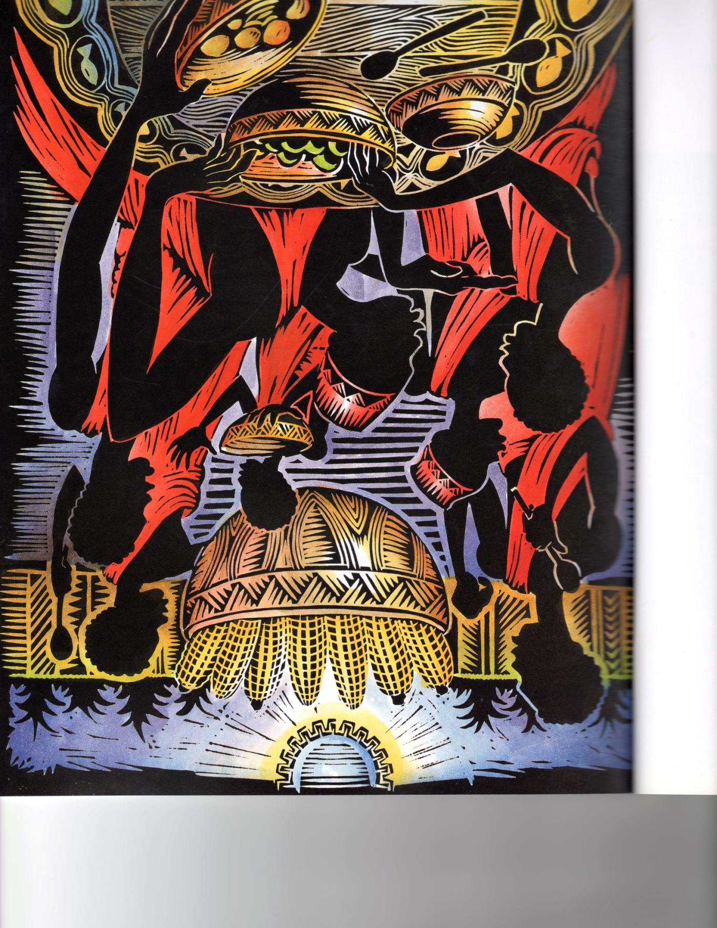
And Quarreling

Slide 5
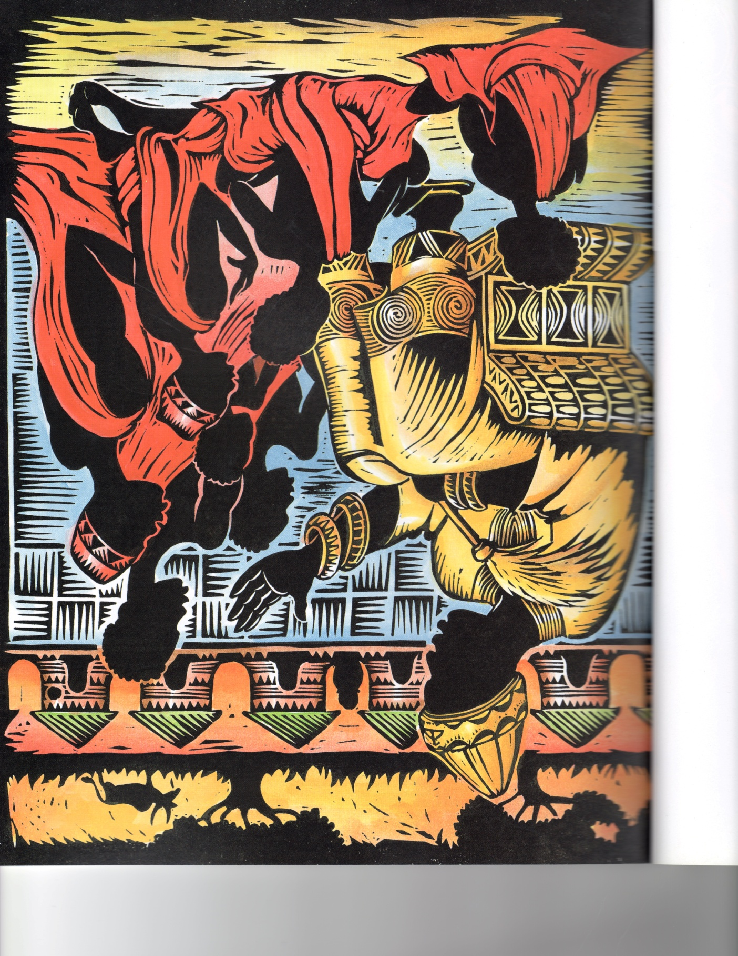
The Village Chief
&
Sons

Slide 6
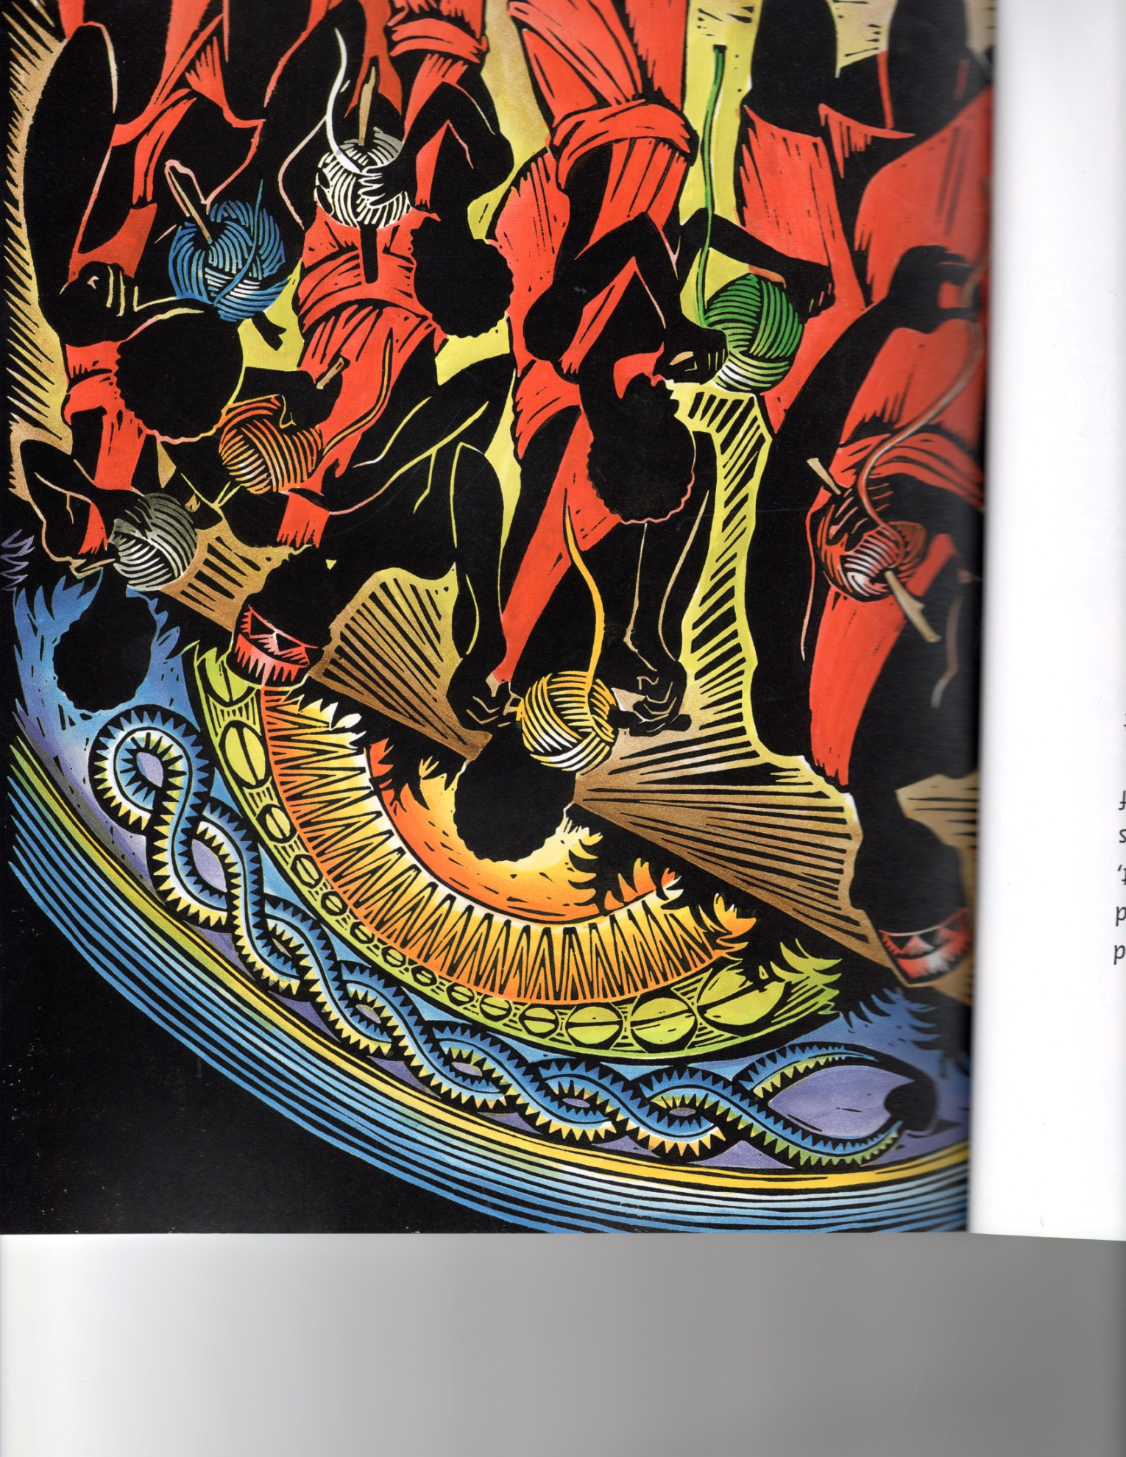
Each Son Received Beautiful Thread

Slide 7
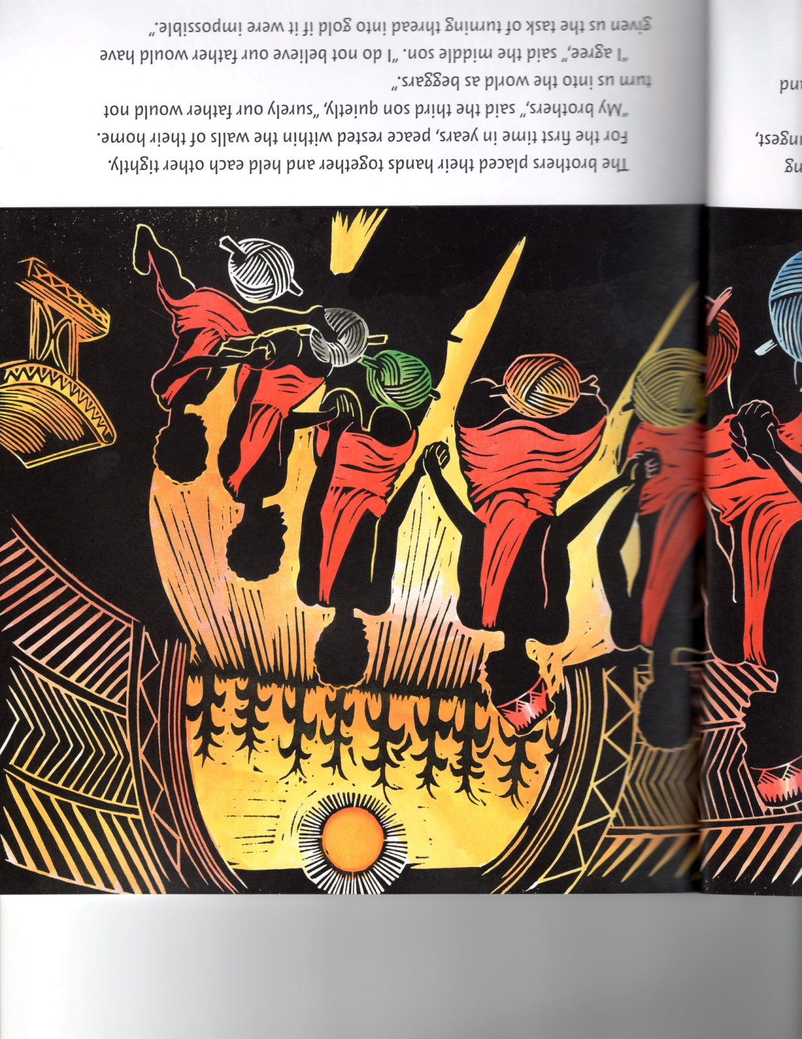
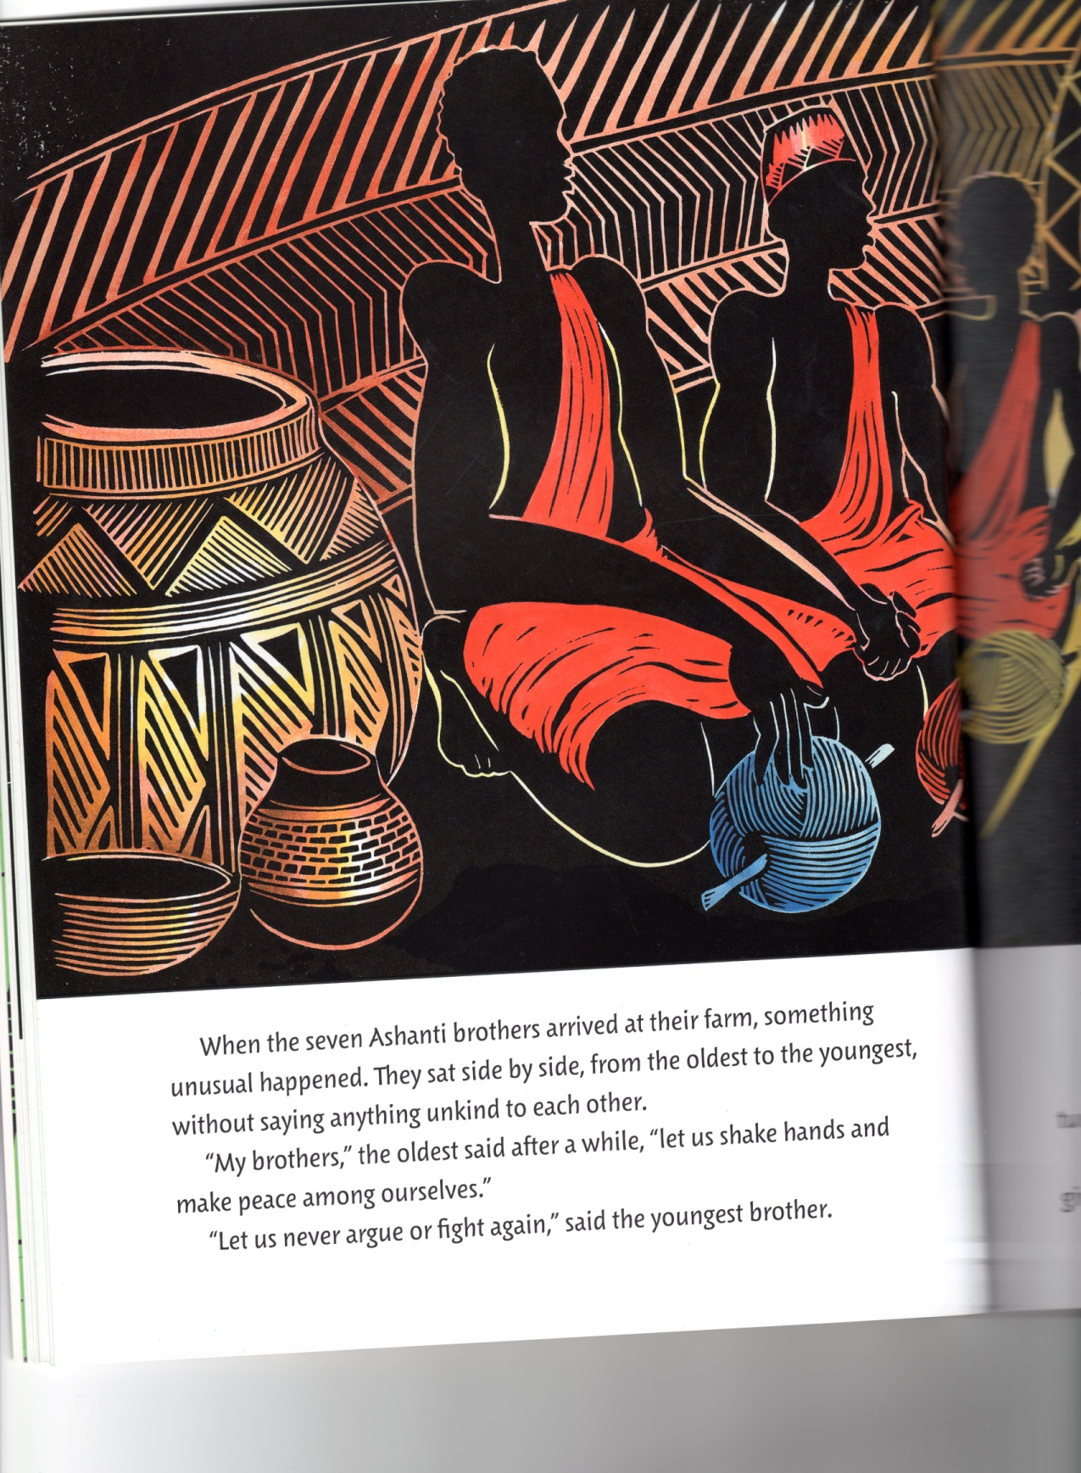
Let Us Make Peace, Brothers!

Slide 8
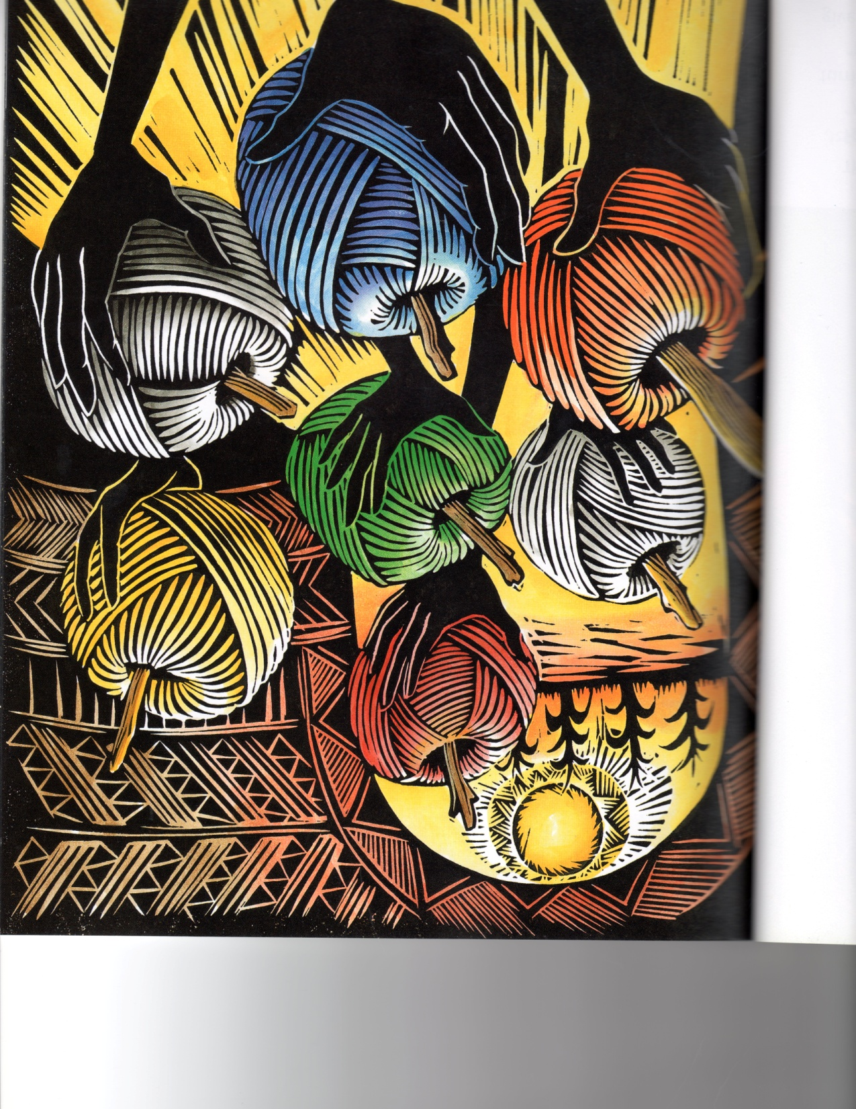

Slide 9
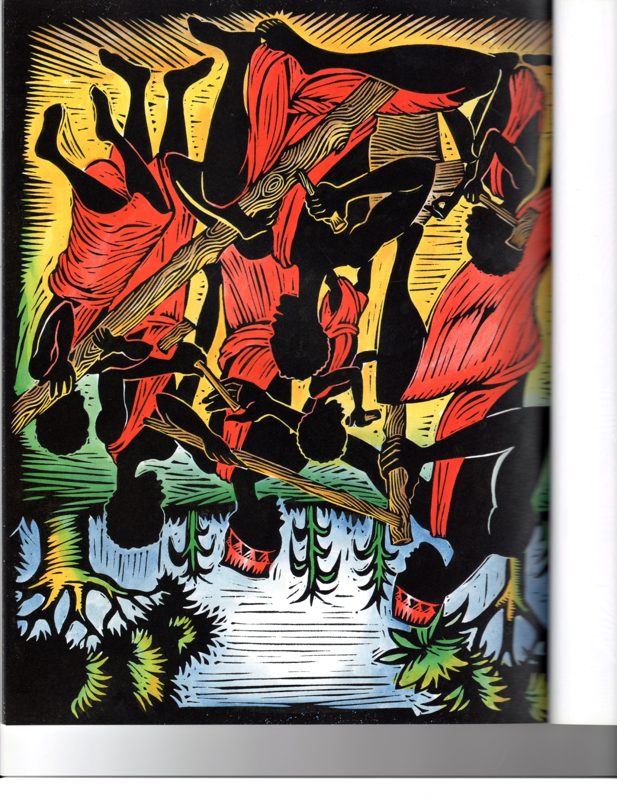
“Let us make some Cloth from our threads”

Slide 10
So, they took turns weaving,

Slide 11
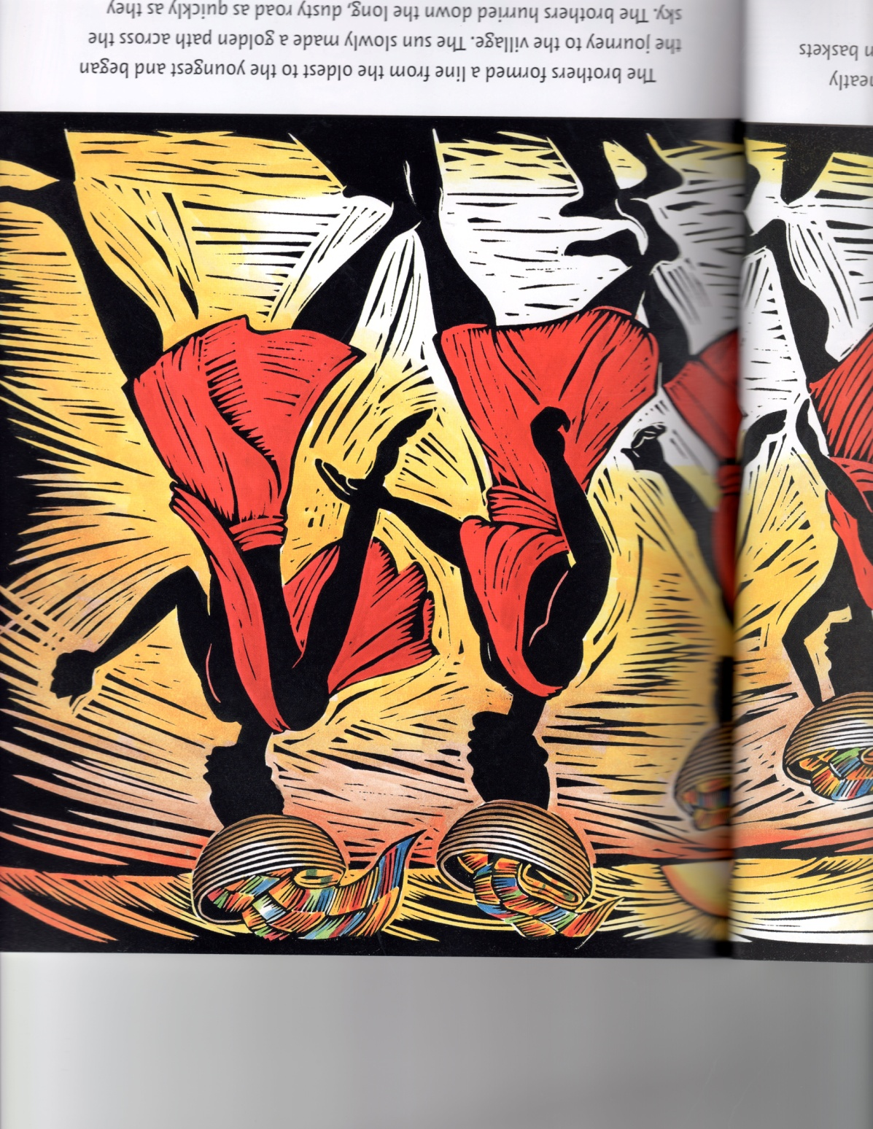
Walking Together

Slide 12
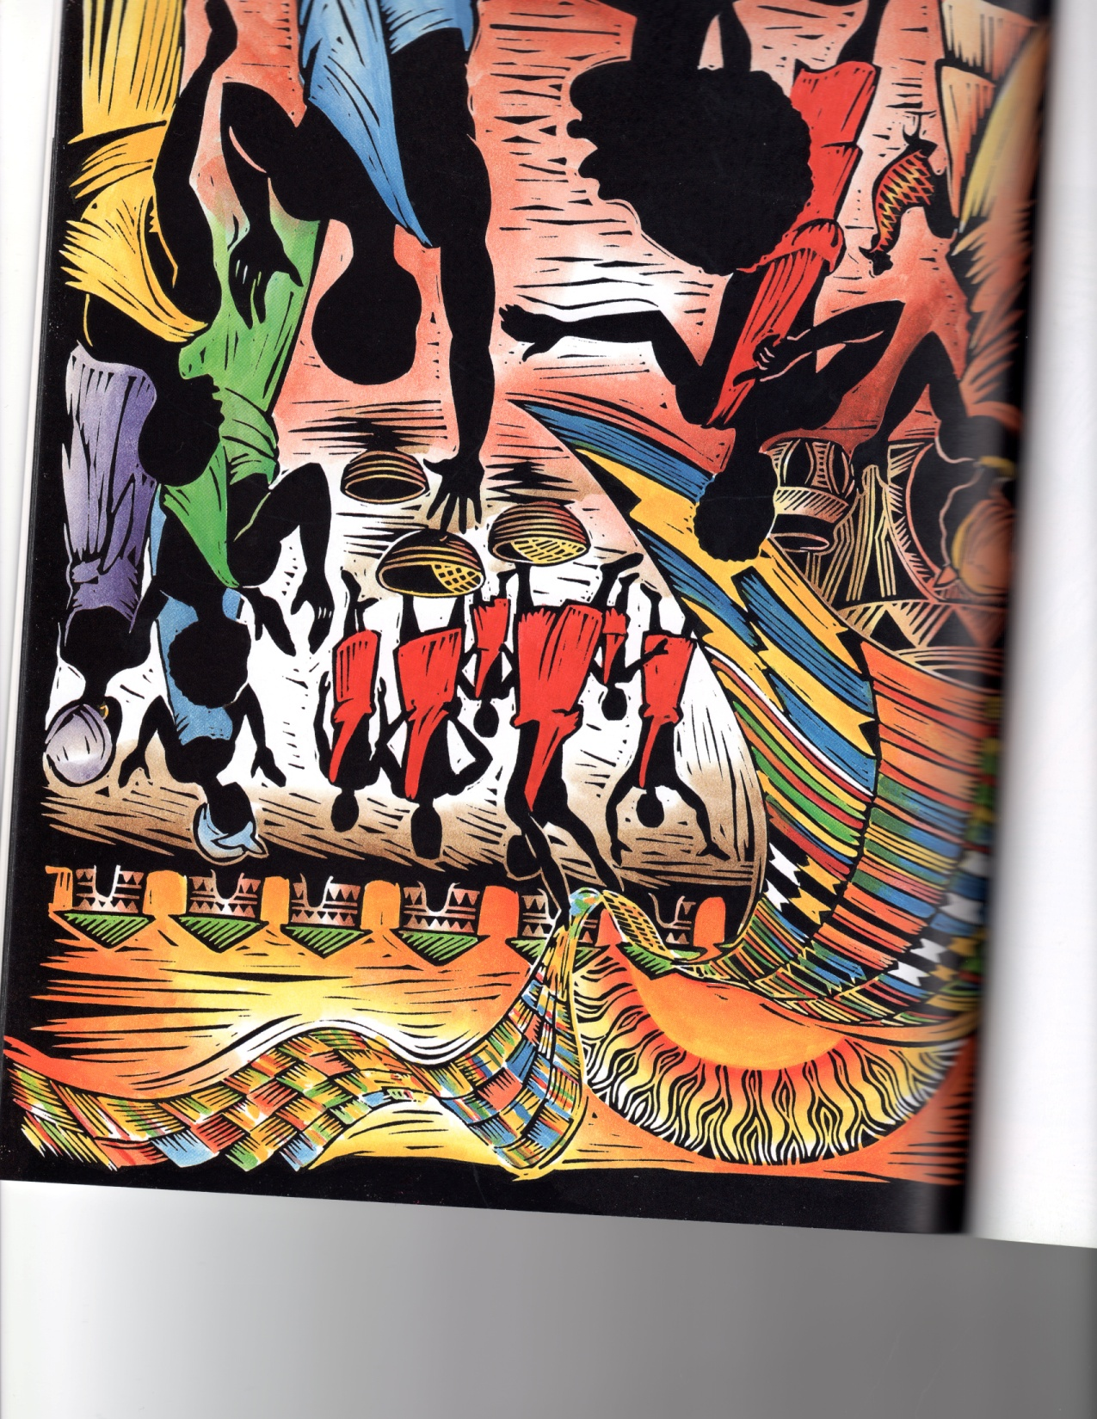
“I Have Never Seen Such Beautiful Cloth”!

Slide 13
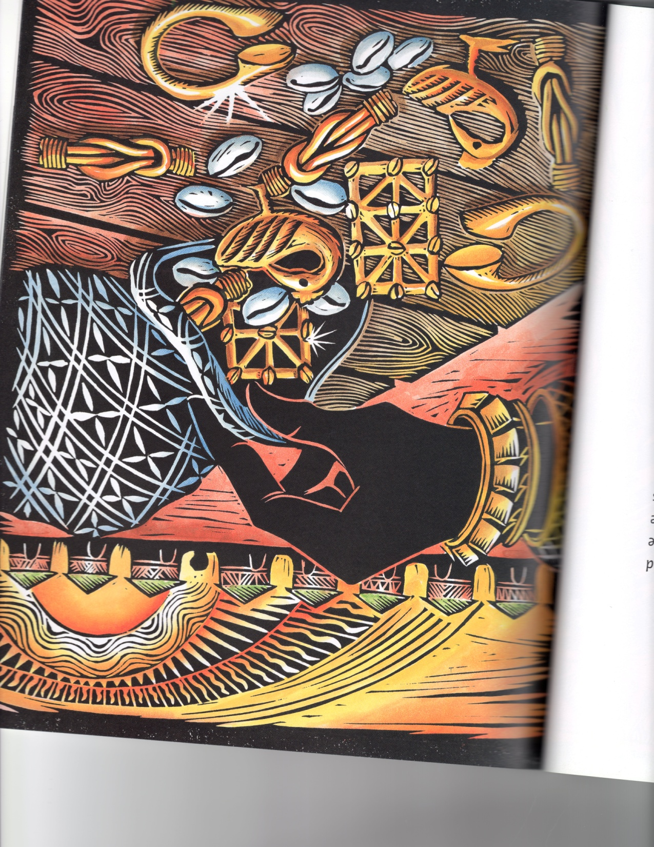
Cloth for a King!

Slide 14
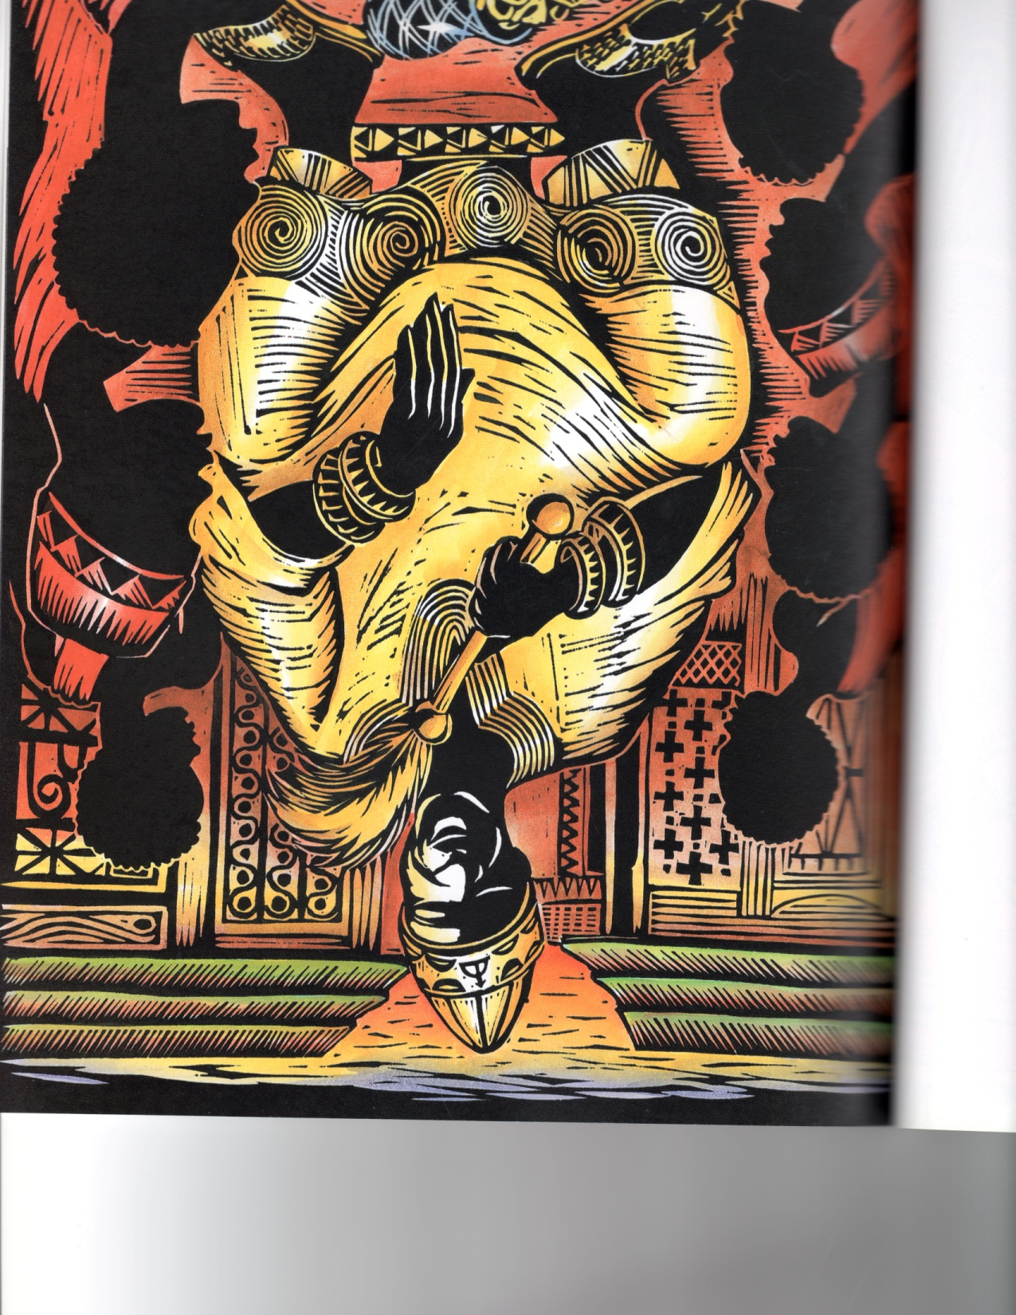

Slide 15
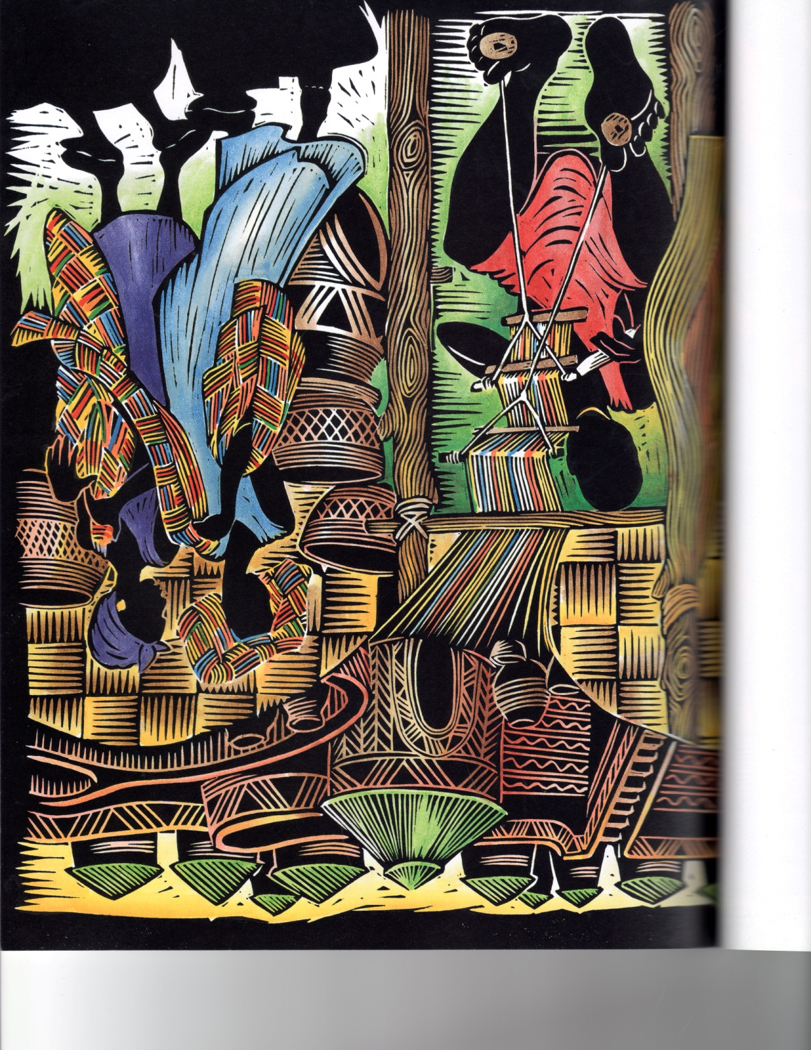
So The People Learn To Make The Kente Cloth

Slide 16
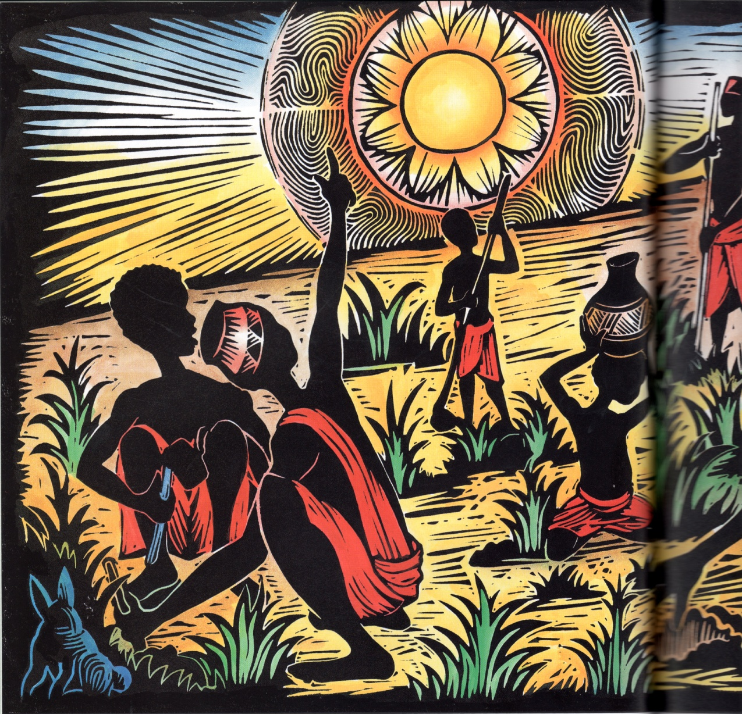
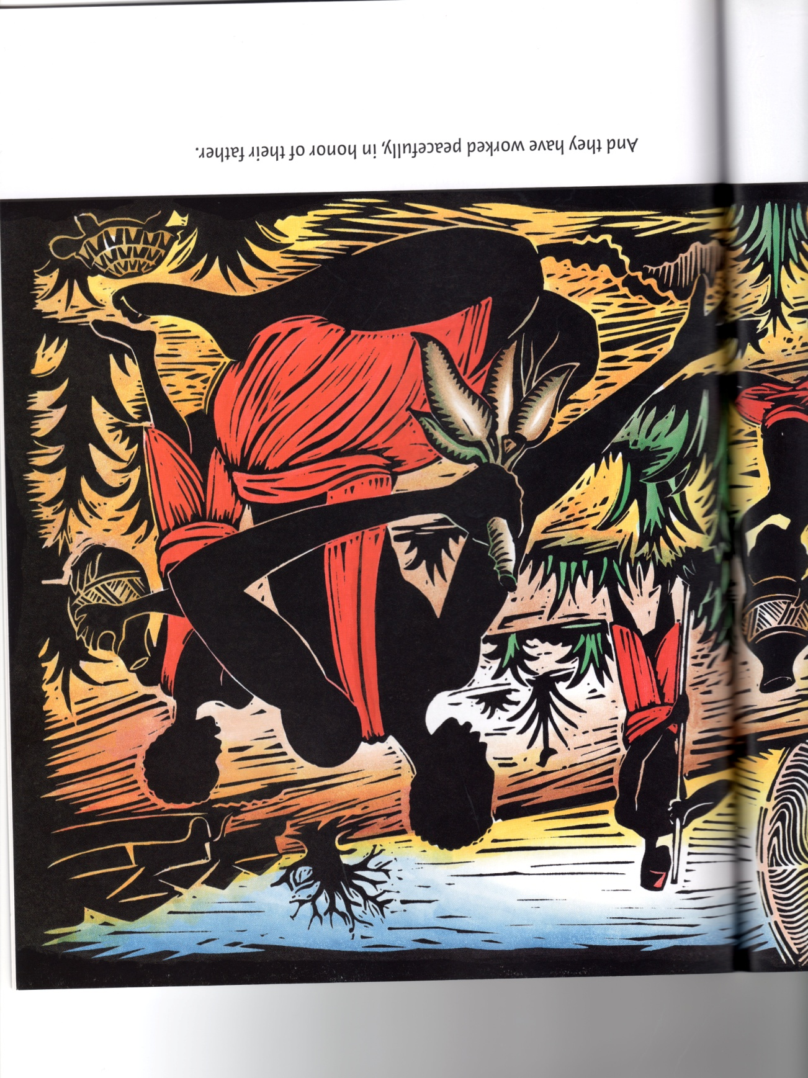
Asé

