Slide 1
Sign me up for the N.A.A.C.P. write my name on the roll. I’ve been changed, since the Lord selected me, I wanna be ready when Freedom comes.

Slide 2
Sign me up for the S.C.L.C. write my name on the roll. I’ve been changed, since the Lord selected me, I wanna be ready when Freedom comes.

Slide 3
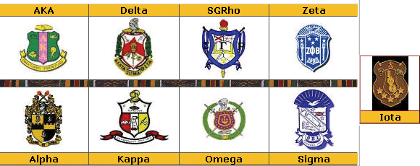
Sign me up for a Fraternity or Sorority, write my name on the roll. I’ve been changed, since the Lord selected me, I wanna be ready when Freedom comes.

Slide 4
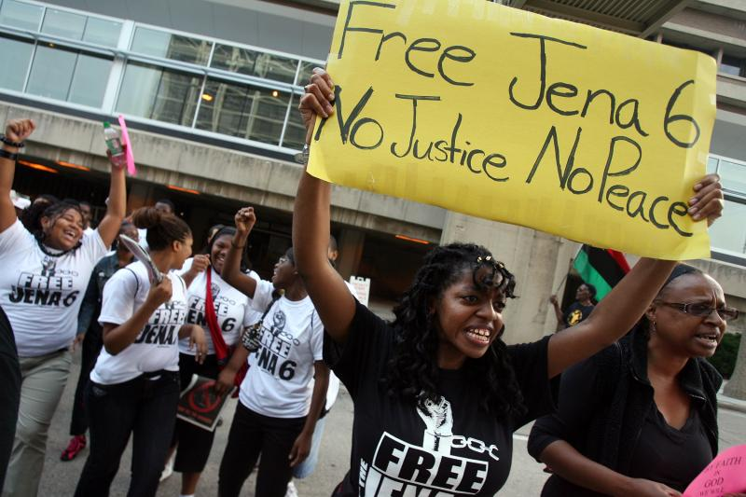
Sign me up for Civil Rights Marching, write my name on the roll. I’ve been changed, since the Lord selected me, I wanna be ready when Freedom comes.

Slide 5
Sign me up for the Order of Eastern Star, write my name on the roll. I’ve been changed, since the Lord selected me, I wanna be ready when Freedom comes.

Slide 6
Sign me up for the Order of Free Masonry, write my name on the roll. I’ve been changed, since the Lord selected me, I wanna be ready when Freedom comes.

Slide 7
Sign me up for the Neighborhood Watch, write my name on the roll. I’ve been changed, since the Lord selected me, I wanna be ready when Freedom comes.

Slide 8
Sign me up for the N.A.B.S.W, write my name on the roll. I’ve been changed, since the Lord selected me, I wanna be ready when Freedom comes.

Slide 9
Sign me up for Black Liberation, write my name on the roll. I’ve been changed, since the Lord selected me, I wanna be ready when Freedom comes.

Slide 10
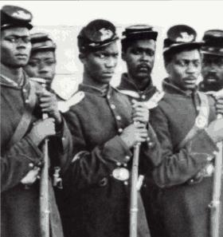
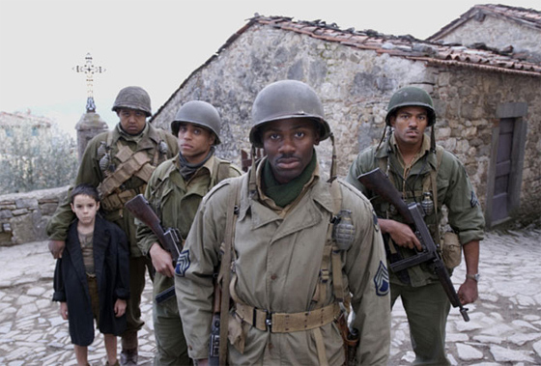
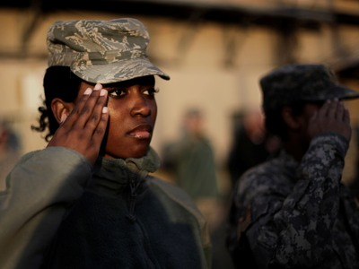
Sign me up for the Military, write my name on the roll. I’ve been changed, since the Lord selected me, I wanna be ready when Freedom comes.

Slide 11
Sign me up for N’COBRA, write my name on the roll. I’ve been changed, since the Lord selected me, I wanna be ready when Freedom comes.

Slide 12
Sign me up for the P.T.S.A., write my name on the roll. I’ve been changed, since the Lord selected me, I wanna be ready when Freedom comes.

Slide 13
Sign me up for the Republic of New Afrika, write my name on the roll. I’ve been changed, since the Lord selected me, I wanna be ready when Freedom comes.

Slide 14
Sign me up for African Unity, write my name on the roll. I’ve been changed, since the Lord selected me, I wanna be ready when Freedom comes.

Slide 15
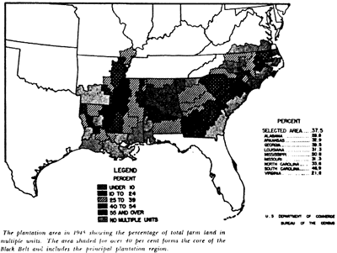
Sign me up for the Black Belt Initiative, write my name on the roll. I’ve been changed, since the Lord selected me, I wanna be ready when Freedom comes.

Slide 16
Sign me up for the United Negro College Fund, write my name on the roll. I’ve been changed, since the Lord selected me, I wanna be ready when Freedom comes.

Slide 17
Sign me up for the Black United Front, write my name on the roll. I’ve been changed, since the Lord selected me, I wanna be ready when Freedom comes.

Slide 18
Sign me up for the W.A.D.U., write my name on the roll. I’ve been changed, since the Lord selected me, I wanna be ready when Freedom comes.
World African Diaspora Union

